Slide 1
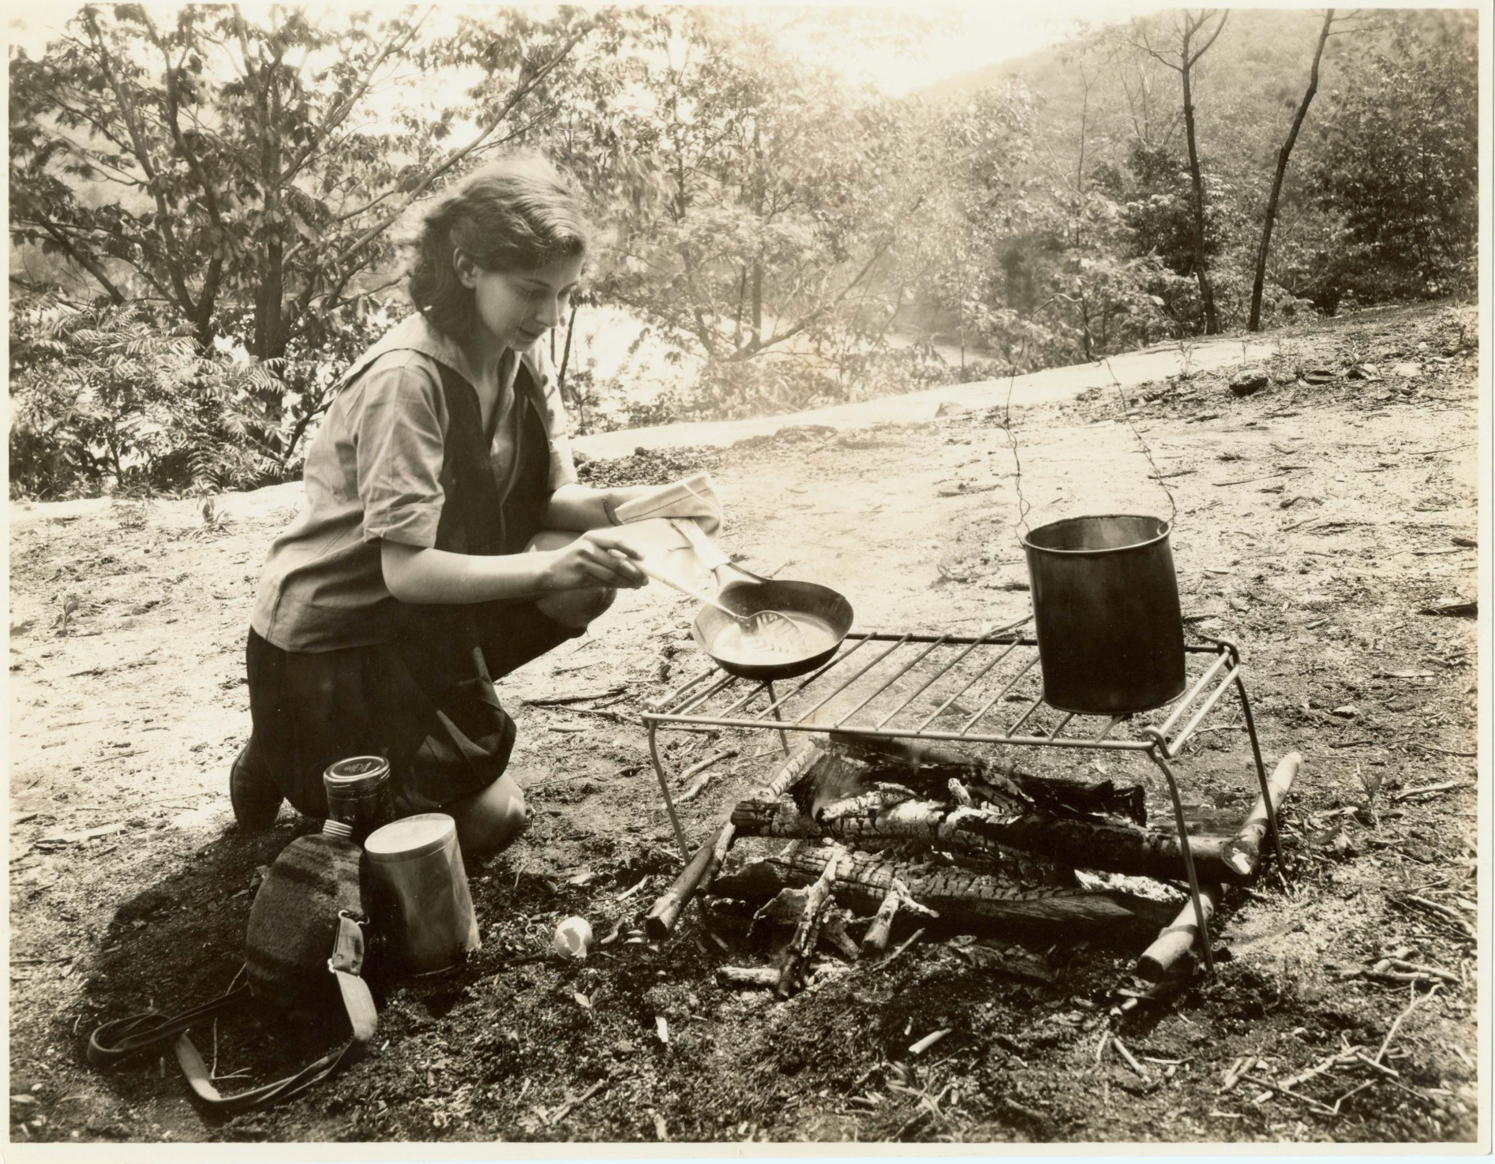

Slide 2
History of Harriman State Park

Slide 3
Before there was a park
Native Americans of Algonquian cultural linage.
Lenape-Delaware
Woodcutters and Coaler's cabins.
Ironworkers and mines worked for nearly 100 years
Found often are musket balls, buttons and other revolutionary debris
The Battle of Fort Montgomery, Battle of Stony Point and more forged the trails that are currently used today.
Furnaces for forging metals
Homes to nearly 2,200 people eventually displaced by the park agreement

Slide 4
Native Americans/ Revolutionary War

Slide 5
Squatters and Furnaces

Slide 6
Schools and General Stores

Slide 7
St. John’s in the Wilderness

Slide 8
Two Governors
Theodore Roosevelt
Foster Voorhees

Slide 9
NY and NJ decide
The Palisades were being quarried at an alarming rate, and the citizens demanded action! Then governors Roosevelt and Voorhees appointed a study established to review the palisades and the issues at hand. Recommendations were made.

Slide 10
In 1899 the Palisades Interstate Park Commission was Established
George Walbridge Perkins
Appointed the first president of the Palisades Interstate Park Commission from beginning in 1900 until 1920.

Slide 11
Major William A. Welch, Builder of Parks
Major William A. Welch served in a number of roles at the PIPC between 1912 and 1940. He began as a junior engineer in the Palisades Interstate Park, assisting with drawing and plans primarily for the construction of park facilities roads. Around 1915, he took over responsibilities as Chief Park Engineer and General Manager, serving in this role until his retirement from the PIPC in 1940.

Slide 12
During his time at the PIPC, Major Welch was responsible for the design and construction of nearly all the parks’ major infrastructure, including all the park dams, Seven Lakes Drive, group camp buildings, the Bear Mountain Administration Building, park electrical and water systems, the Storm King Highway, the Popolopen Viaduct, the Bear Mountain Bridge, and more. He was the founder of the Palisades Trail Conference, which became the NY-NJ Trail Conference and helped design and build the first section of the Appalachian Trail and the Long Path.
Major Welch is one of the most significant figures in US environmental and outdoor recreational history, yet very few people know his name.

Slide 13
Harriman was an early addition to the Palisades Interstate Park Commission.

Slide 14
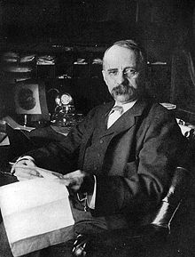
EH and Mary Harriman create a legacy

Slide 15
1909
A dedication of the commission was held with a who’s who of those contributing including Cleveland Dodge, JP Morgan, Lydia Lawrence and Mary Harriman. Pictured here is W Averell Harriman presenting a check for $1,000,000 as well as the deed to 10,000 acres of land near Arden.

Slide 16
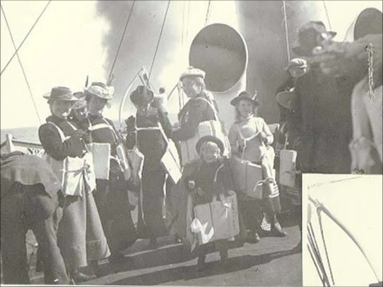
Harriman Expedition to Alaska
Prior to the gift of $1,000,000 and 10,000 acres, the Harriman family took a journey that would instill a sense of conservation in them all.

Slide 17
Joining the trip was a group of scientists and Conservationists
John Burroughs
John Muir

Slide 18
1913 The Land is open to the young for camping

Slide 19
1915 Bear Mountain Inn Opens

Slide 20
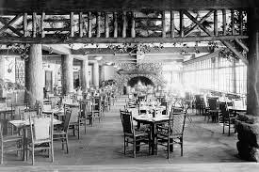
As the centerpiece of a unique park system that stretches from the edge of New York City through the Hudson Valley, the Bear Mountain Inn was declared by The American Architect to be one of the “finest examples of rustic Adirondack architecture in America” upon its opening in 1915.

Slide 21
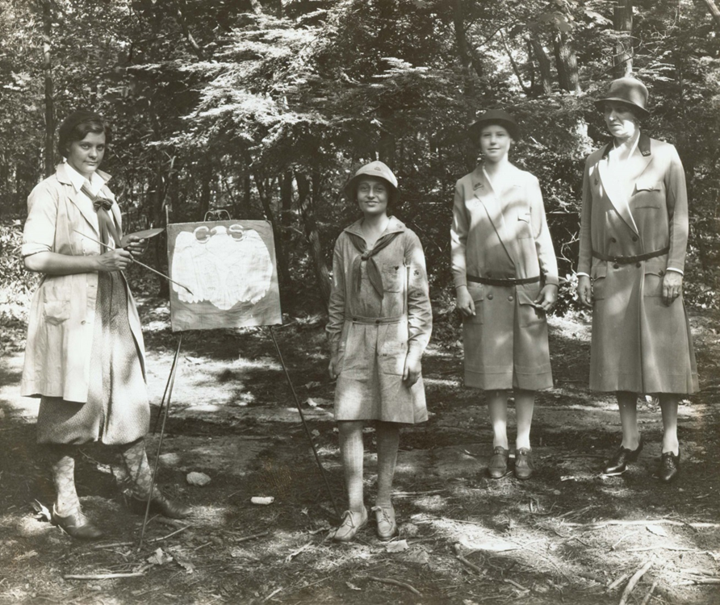
Boy and Girl Scouts were brand new…

Slide 22
Boy Scouts were establishing camps
Lake Stahahe
Lake Kanawauke

Slide 23
Boy Scout Headquarters Lake Kanawauke

Slide 24
1919 Uncle Bennie and the Regional Nature Museums

Slide 25
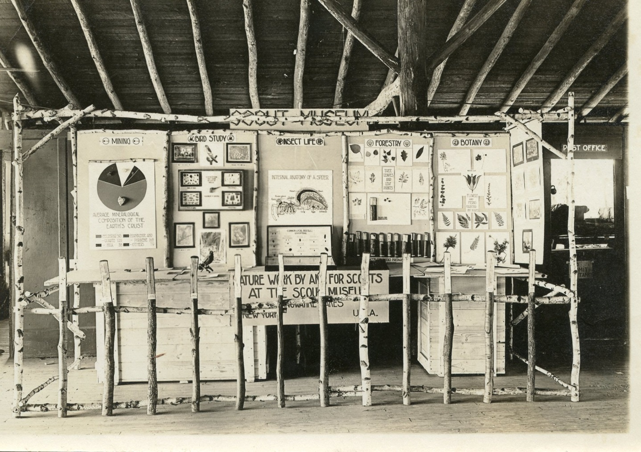
A corner dedicated to nature

Slide 26
By now thousands were in camp every summer

Slide 27
1925 Frank Lutz designs a Nature Trail

Slide 28
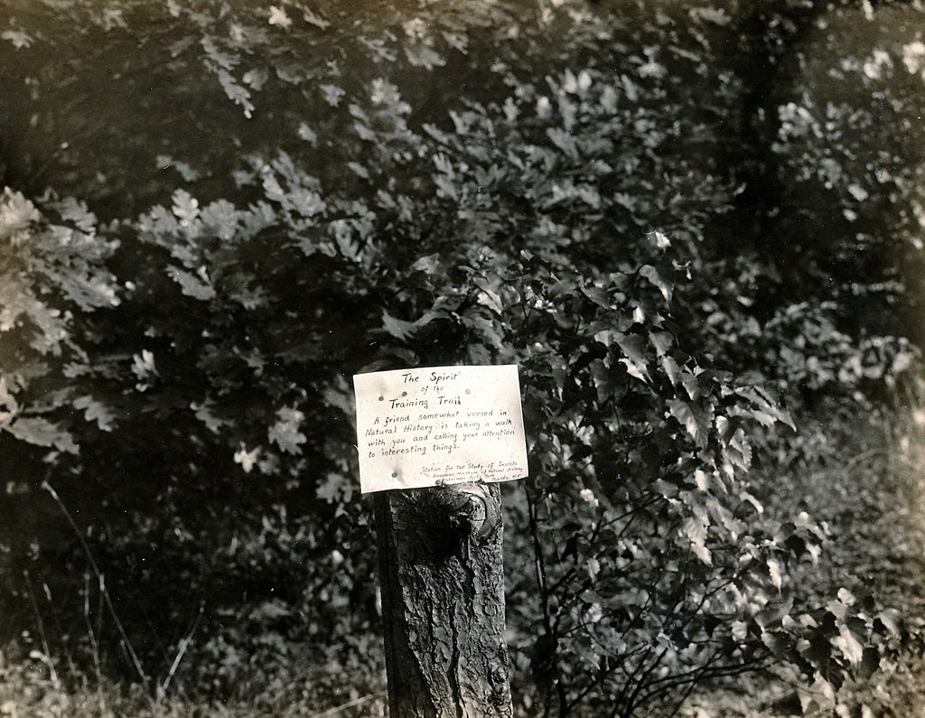
The first nature trail in the United States was created in 1925 at Harriman State Park's Station for the Study of Insects, established by Dr. Frank E Lutz of the American Museum of Natural History in cooperation with the Palisades Interstate Park.
Lutz developed a trail around the station and posted small signs to identify interesting trees, plants, insect haunts, and other natural features. In so doing, he created the first nature trail in the United States. In 1926 Lutz transplanted his educational techniques and scientific interest to Bear Mountain by establishing the Trailside Museum in cooperation with the American Museum of Natural History. The Trailside Museum and Wildlife Center remains a significant asset for the PIPC.

Slide 29
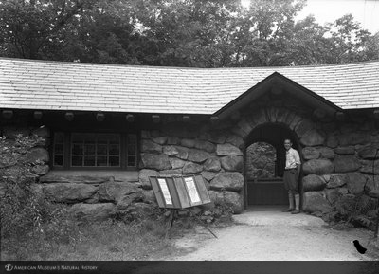
Trailside Museum and Wildlife Center opens in 1927William Carr – Director of Trailside

Slide 30
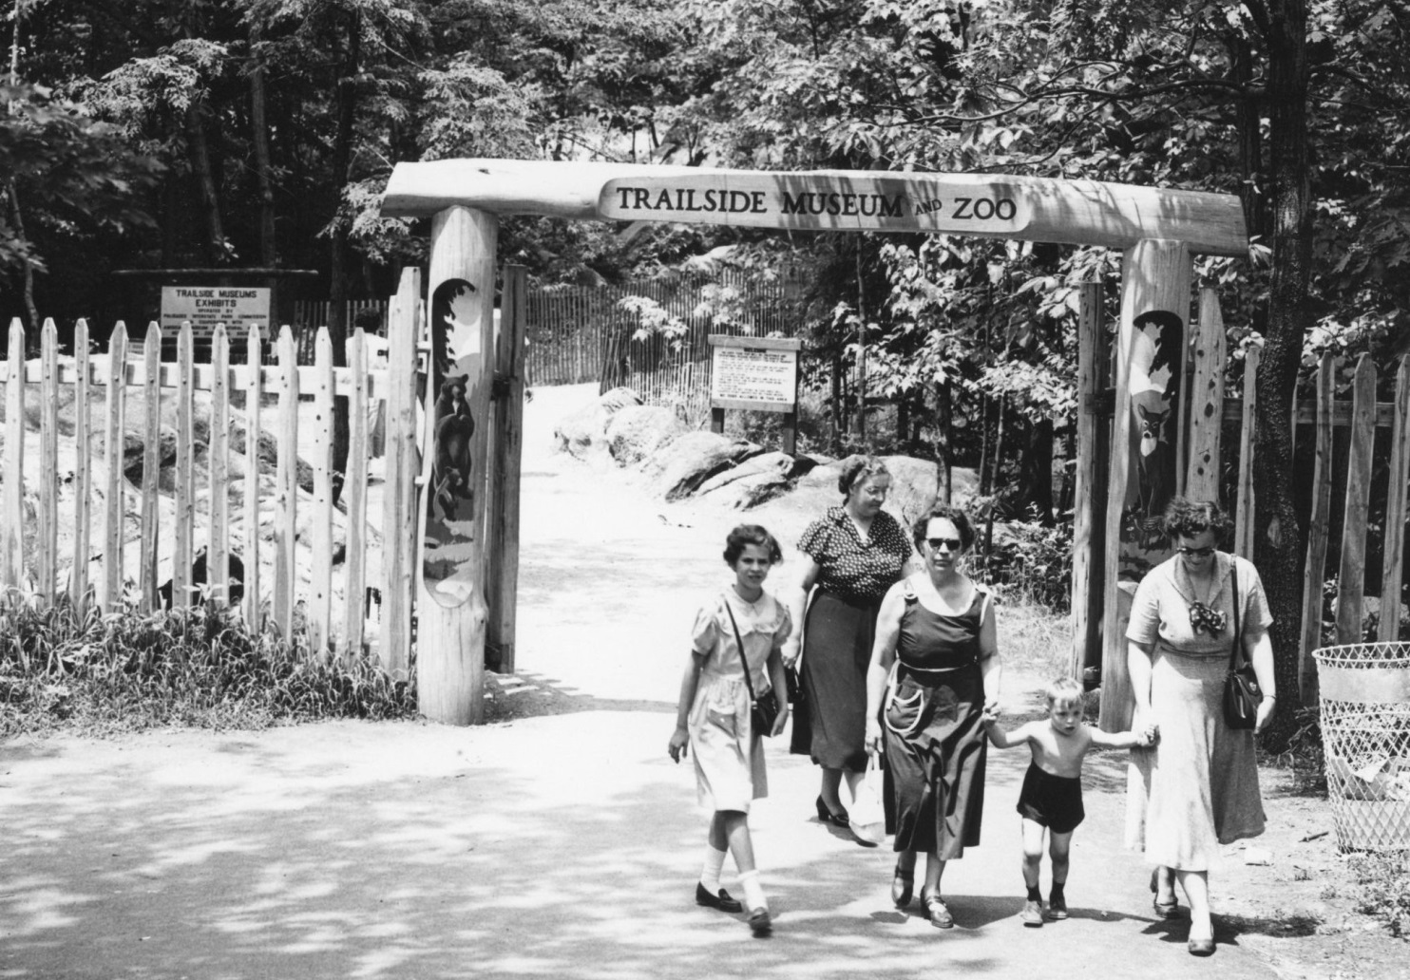
Trailside the Early Years

Slide 31
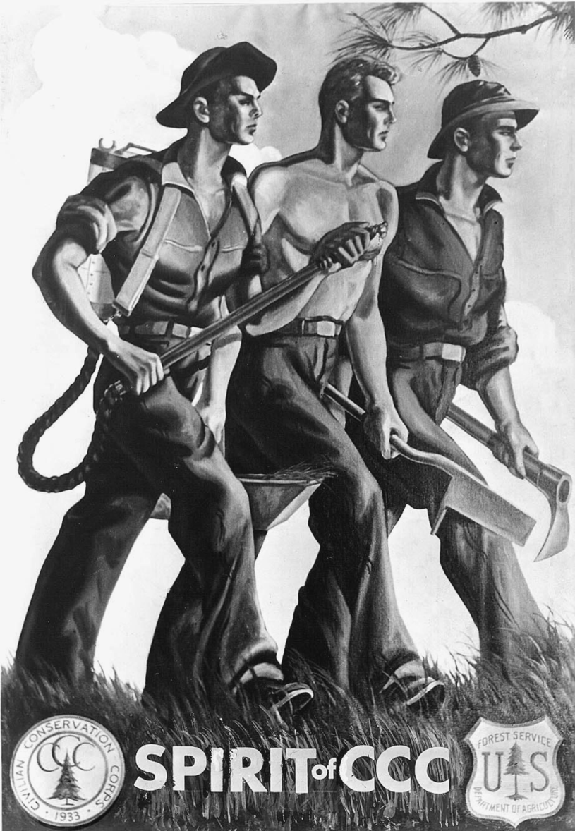
CCC
I propose to create the CCC to be used in complex work, not interfering with normal employment and confining itself to forestry to the prevention or soil erosion, flood control, and similar projects. I call your attention to the fact that this type of work is definite, practical value, not only through the preservation of great present financial loss but also as a means of creation a future national wealth.

Slide 32
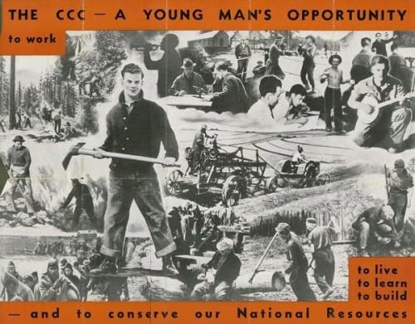
Each camp was located wherever work was to be performed up to 200 men were assigned to a temporary community that included staff quarters, medical dispensary, mess hall, recreation hall, offices and tool rooms. There were blacksmiths and motor pool garages.
The goal was to educate and train, learn the lay of the land and be ready to be a member of working society with skills to boot.

Slide 33
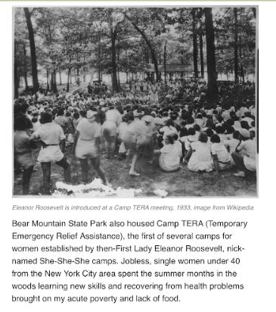
WCC-
She-She-She

Slide 34
1930’s
Rockefeller family continue to give, land that is now the Rockefeller Lookout. Connecting more of the greenway of the Hudson.

Slide 35
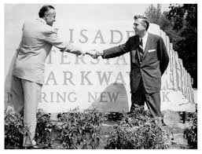
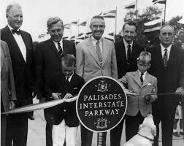
1958 Dedication of the Parkway
The Palisades Interstate Parkway is a scenic 42-mile ride from the George Washington Bridge to the Bear Mountain Bridge.

Slide 36
1980 Storm King
Storm King Mountain land totaling 1,888 acres was donated by the Calvin W. Stillman family in a formal agreement.

Slide 37
1986
Minnewaska after a 17-year effort, and numerous individuals and organizations rallying, formally became Minnewaska State Park, encompassing 13,000 acres.

Slide 38
1998
Sterling Forest’s 16,380 acres was permanently protected, officially signed into PIP property.

